Slide 1

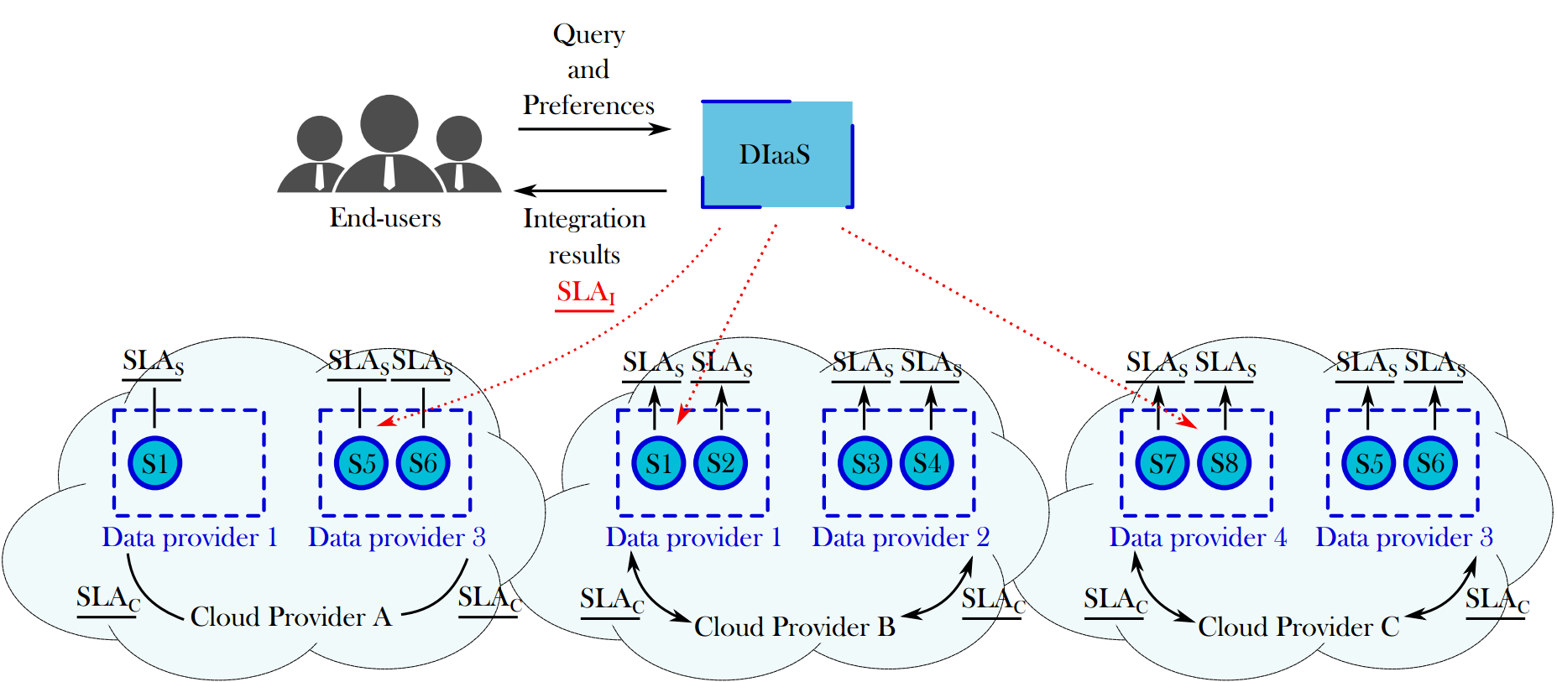
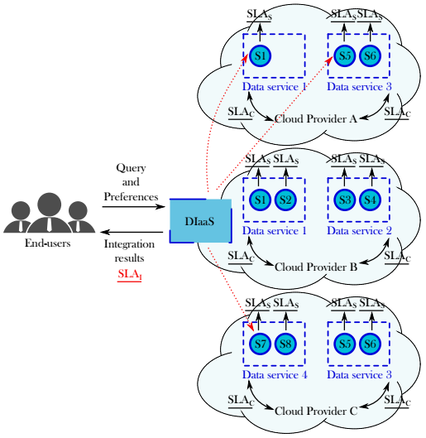
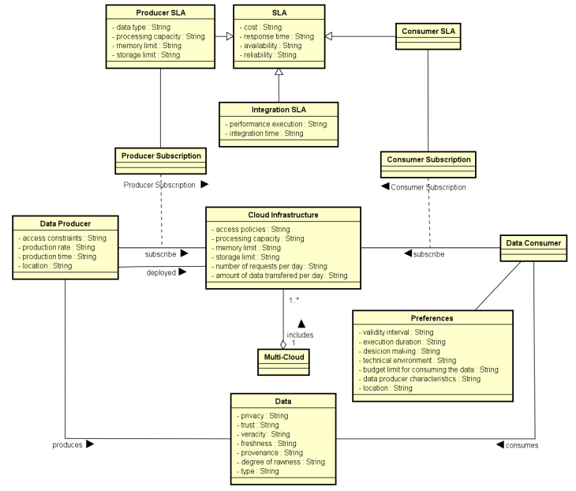




Mondes numériques pour l’humain et la société : conception, comportements et usages
ARC 6 : Technologies de l’Information et de la Communication
et Usages Informatiques Innovants
Trusted SLA-Guided Data Integration on Multi-cloud Environment
The emergence of cloud environments redefined the data integration as service matching and composition problem. Furthermore, new constraints imposed by multi-cloud environments bring new challenges to data integration systems.
Thus, general objective of this research is to propose a data integration approach in a multi-cloud environment taking into account data quality properties and service level agreements (SLA).
POINTS CLES
TRAVAUX ENGAGES / RESULTATS
Model quality measures linked to data and to cloud resources
Use Service Level Agreement (SLA) for guiding the data integration process performed on a multi-cloud
Match data providers (services) to queries for integrating data according to the user requirements and the SLAs.
Problem statement and state of the art by applying a systematic mapping process.
Rhône algorithm: formalization and implementation of a quality-based query rewriting considering user preferences and quality aspects expressed as SLA contracts.
Query definition: formalization of the different type of query variations according to the user requirements, and proposed solution for each case.
Heuristics: proposal of heuristics applied to the new context in order to reuse as much as possible previous results in a further integration.
SLA schema: designing and modeling of the different schemas of SLA contracts. Ongoing work on defining the integration SLA.
PROBLEMATIQUE
Efficiently obtain results for queries addressing services deployed in a multi-cloud environment by: (a) Fulfilling user QoS requirements; (b) Respecting subscribed contracts with the involved cloud provider(s); and (c) Respecting services contracts (constraints).
Challenges:
How to be sure that all the agreed SLAs are respected while satisfying the user?
Can my constraints be satisfied? Which services shall I ask for?
How can resources be saved for next query?
How to perform the query rewriting matching services that answer the query and satisfy the quality preferences?
How to integrate different SLA associated to services involved with user’s quality preferences?
Cloud SLA Schema
SLA identifier | Parties
Service definition
Billing method | Violations
Price | Penalties
Validity period
Availability | Memory limit
Response time | Number maximum of VMs
Throughput | Processing capacity
Amount of data transferred per day
Authentication | Data protection
Privacy | Data integrity
Confidentiality
Storage space | Backup frequency
Data location | Backup portability format
Data transfer cost
Service SLA Schema
SLA identifier | Parent SLA identifier
Service definition
Validity period | Number of requests per day
Price per call
Availability
Response time
Authentication
Privacy
Confidentiality
Data type | Degree of rawness
Veracity | Production rate/time
Provenance | Freshness
____________
D. A. S. Carvalho, P. A. Souza Neto, G. Vargas-Solar, N. Bennani, C. Ghedira, Can Data Integration Quality be Enhanced on Multi-cloud using SLA?, In 26th Int. Conf. on Database and Expert Systems Applications, Spain, 2015.
D. A. S. Carvalho, P. A. S. Neto, C. Ghedira, G. Vargas-Solar, N. Bennani. Rhone: a quality-based query rewriting algorithm for data integration.. East-European Conference on Advances in Databases and Information Systems, Aug 2016, Prague, France. ADBIS East-European Conference on Advances in Databases and Information Systems, 2016.
D. A. S. Carvalho, P. A. S. Neto, C. Ghedira, G. Vargas-Solar, N. Bennani. Towards Quality Guided Data Integration on Multi-Cloud Settings. 14th international conference on service oriented computing (ICSOC), Oct 2016, Banff, Alberta, Canada.
Daniel Aguiar da Silva Carvalho, Magellan, IAE, Univ. J-Moulin Lyon 3 - France
Chirine Ghedira Guegan, Magellan, IAE, Univ. J-Moulin Lyon 3 - France
Nadia Benani, CNRS INSA-Lyon, LIRIS, UMR5205 - France
Genoveva Vargas-Solar, CNRS, LIG-LAFMIA, Saint Martin d'Hères - France

